Slide 1
INTRODUCTION TO BIG DATA CAPSTONE PROJECT
NAMES: ISARO MUHIRWA OLA
ID: 26878

Slide 2
NUTRITION PROJECT INTRODUCTION
This project explores trends in childhood malnutrition in Rwanda using open-source data from the World Health Organization.
It focuses on three key indicators:
1. Anaemia in children aged 6–59 months
2. Stunting (chronic malnutrition)
3. Underweight (low weight for age)

Slide 3
METHODOLOGY
Dataset Source: Humanitarian Data Exchange (HDX)
https://data.humdata.org/dataset/who-nutrition-indicators-for-rwanda
Tools Used:
1. Python (Pandas, Regex) for data cleaning and preprocessing
2. Power BI for data visualization
3. GitHub for version control and documentation

Slide 4
STEPS
1. Loaded and cleaned structured WHO nutrition CSV file
2. Filtered indicators related to anaemia, stunting, and underweight
3. Cleaned text-based numeric fields using regular expressions
4. Exported three cleaned datasets for visualization
5. Built interactive Power BI dashboards

Slide 5
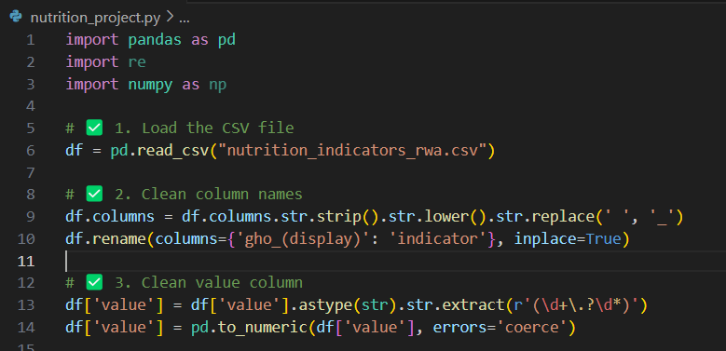
LOADING AND CLEANING CSV FILE
→ Imported the CSV file and checked its structure using Python (Pandas).
→ Cleaned column names and value column for easier handling

Slide 6
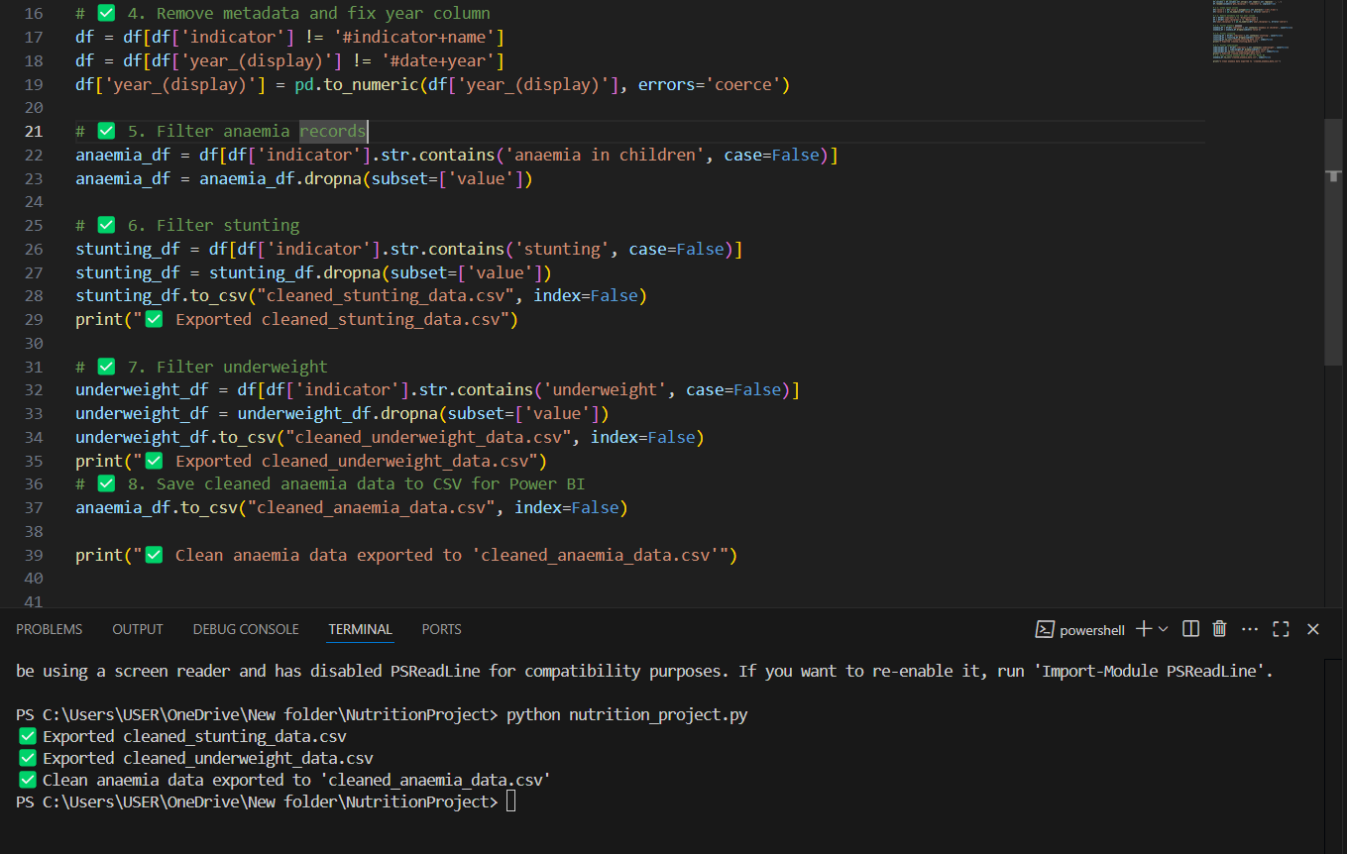
Filtering and saving
→ Removed metadata by dropping invalid rows and converted the year column to numeric type.
→ Filtered anaemia, stunting and underweight data
→ Saved all the cleaned dataset to CSV

Slide 7
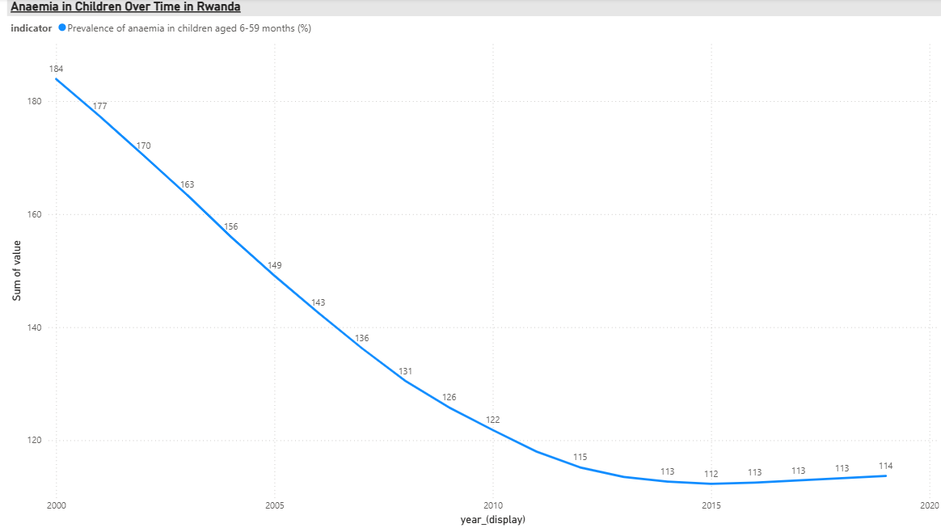
RESULTS
Anaemia
It showed significant fluctuations across years with peak periods around 2005 and 2015.

Slide 8
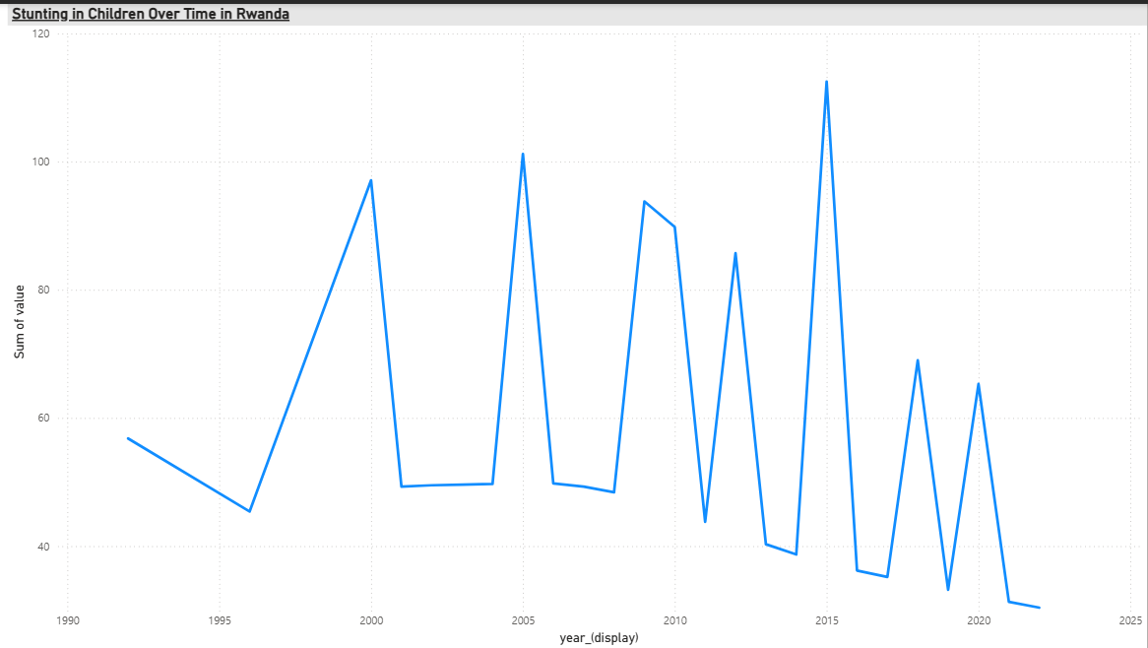
2. STUNTING
Appeared consistently over decades, indicating a long-term public health issue.

Slide 9
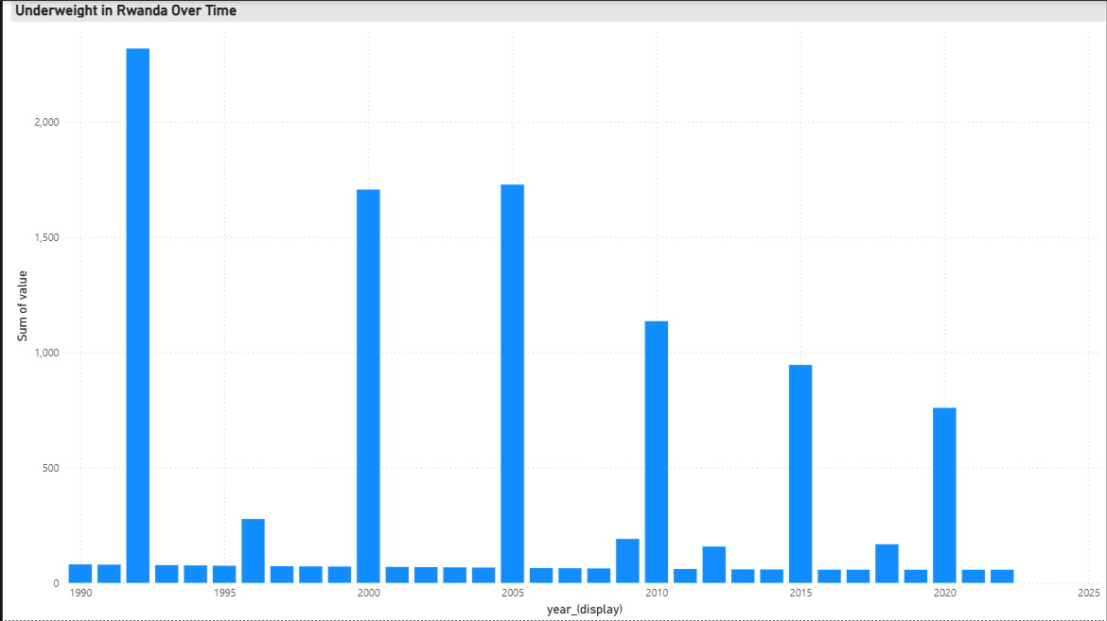
3. UNDERWEIGHT
Values declined in recent years but remained notable in early 2000s

Slide 10
RECOMMENDATIONS
Increasing targeted interventions in rural areas and for children under five.
To continue long-term investment in maternal and child nutrition education.
Encouraging the use of tools like Power BI in government health monitoring systems for real-time trend analysis

Slide 11
FUTURE WORK
Expanding dataset to include more dimensions (e.g., by region or gender)
Predicting future malnutrition trends using machine learning
Combining nutrition data with socioeconomic indicators for deeper insights

Slide 12
END

